Slide 1
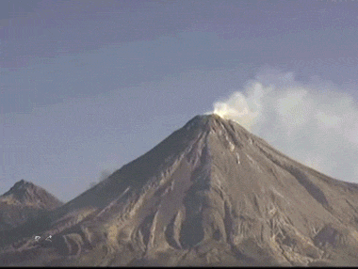

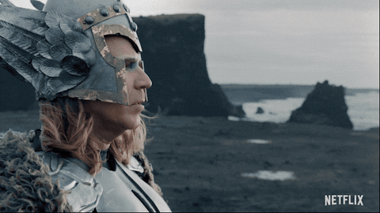
Title: Living with Tectonic Hazards
LO: Why do people choose to live near tectonic hazards?
Title: Living with Tectonic Hazards
Last Lesson: Name one way Japan prepares for earthquakes.
Two Lessons Ago: Describe the difference between a social and an economic impact.
Three Lessons Ago: Explain why the secondary impacts were bigger than the primary impacts in the 2010 Iceland eruption.

Slide 2
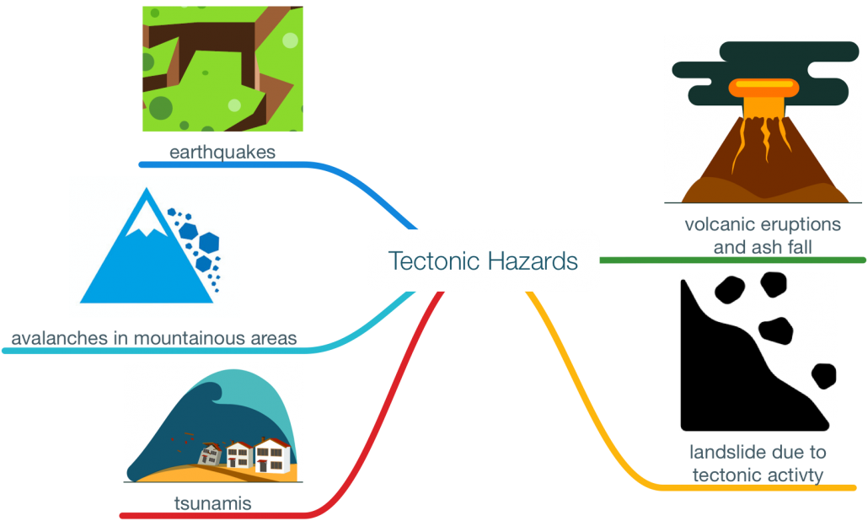
Title: Living with Tectonic Hazards
LO: Why do people choose to live near tectonic hazards?
Date: Tuesday 25th November 2025
Title: Living with Tectonic Hazards
Success Criteria:
🧭 Meeting: Can describe where tectonic hazards occur and identify some reasons why people live near them.
🔎 Exceeding: Can explain why people choose to live near tectonic hazards, using clear examples of benefits and risks.
🧠 Mastering: Can analyse why people continue to live in hazardous areas and evaluate how advantages and management strategies outweigh the dangers.

Slide 3



Title: Living with Tectonic Hazards
LO: Why do people choose to live near tectonic hazards?
Key Terms
Hazard |  | A natural event, like an earthquake or volcano, that can cause damage or danger to people.
Risk |  | The chance of people being harmed or losing property because of a hazard.
Benefit |  | A positive reason why people might choose to live in a risky area, like fertile land or jobs.

Slide 4
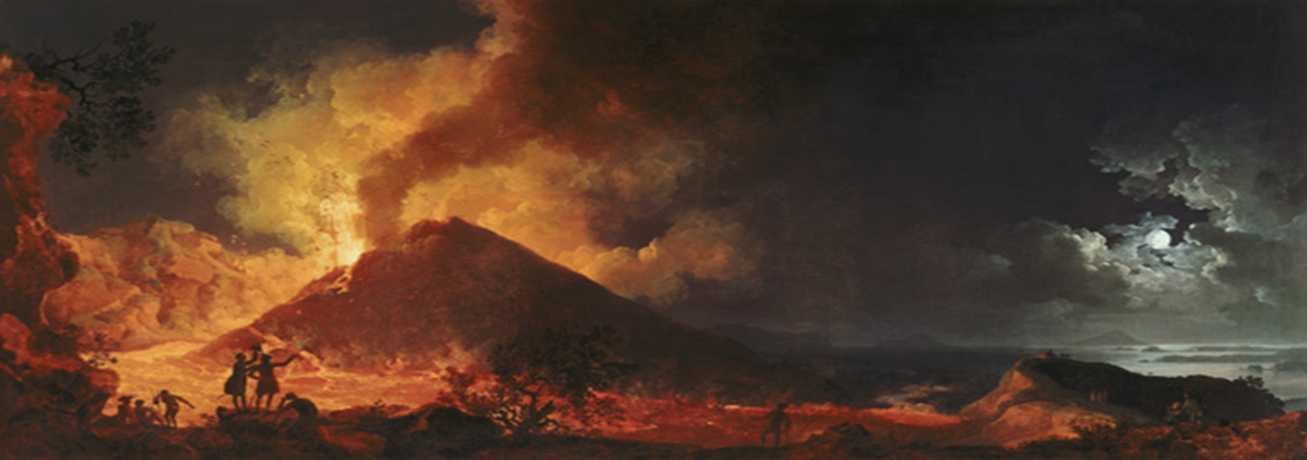
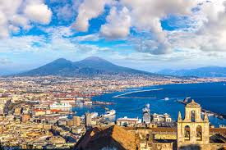
Title: Living with Tectonic Hazards
LO: Why do people choose to live near tectonic hazards?
Living in the Shadow of a Volcano: Mount Vesuvius - Italy
In AD 79, Mount Vesuvius in southern Italy erupted. The volcano buried the nearby cities of Pompeii and Herculaneum in ash and killed thousands of people.
Today, over one million people live near Vesuvius, mostly in the city of Naples. Vesuvius last erupted in 1944, but in the past it erupted about every 20 years. Many people believe it is now long overdue for another eruption.

Slide 5
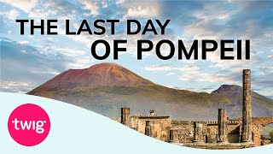
Title: Living with Tectonic Hazards
LO: Why do people choose to live near tectonic hazards?
Living in the Shadow of a Volcano: Mount Vesuvius - Italy
What was the Roman city of Pompeii like before the eruption of Mount Vesuvius in AD 79?
How did the first pyroclastic surge affect Pompeii and its people?
How was Pompeii preserved and when was it rediscovered?
A wealthy, busy city near Mount Vesuvius, which people thought was safe.
Killed many people with toxic gas and ash.
Under ash and rock and rediscovered in 1594.
Notes:
https://www.youtube.com/watch?v=YIZ4aSKT3mo

Slide 6

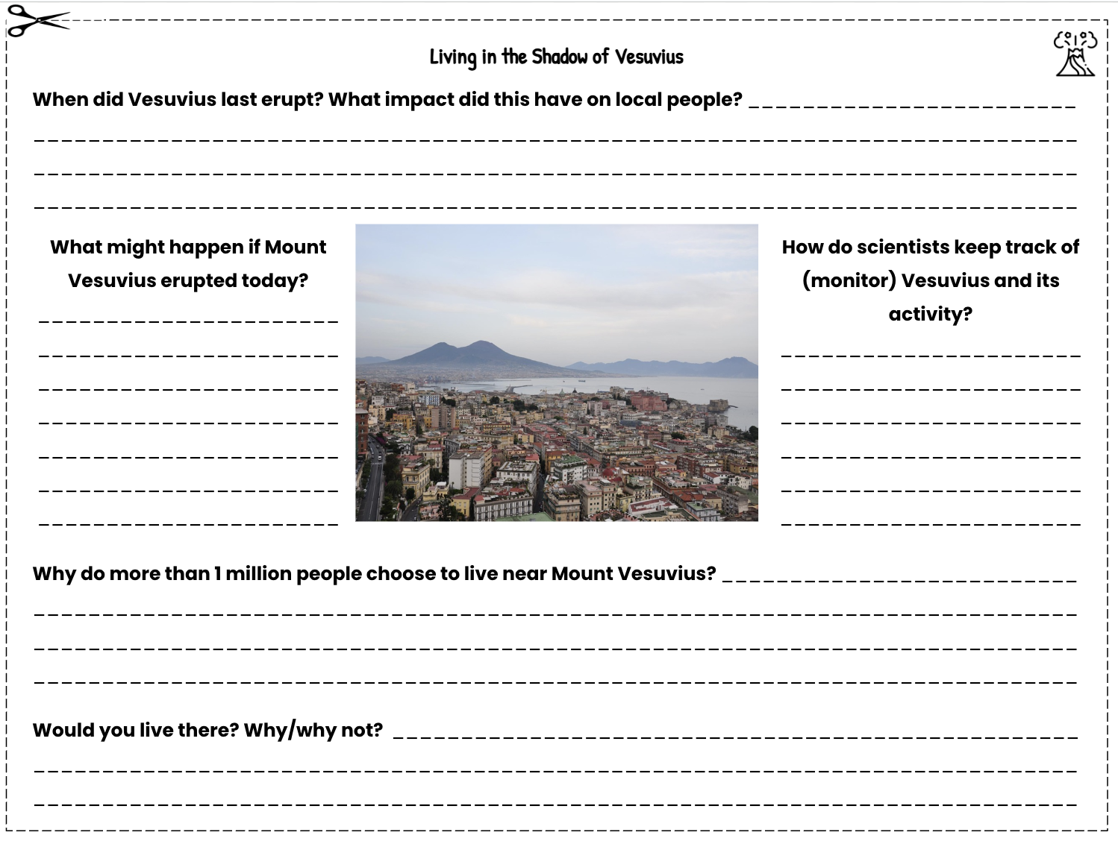

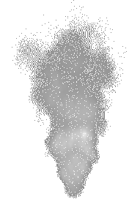
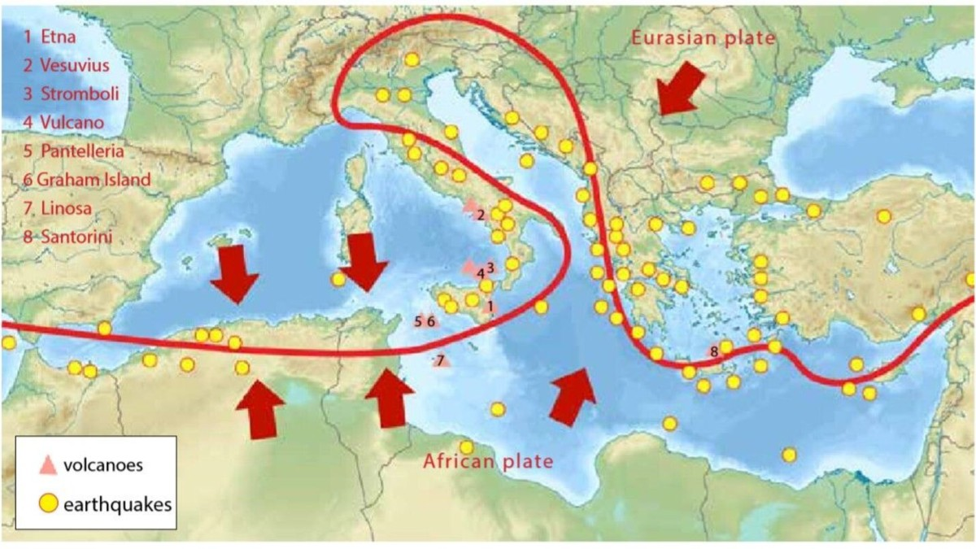

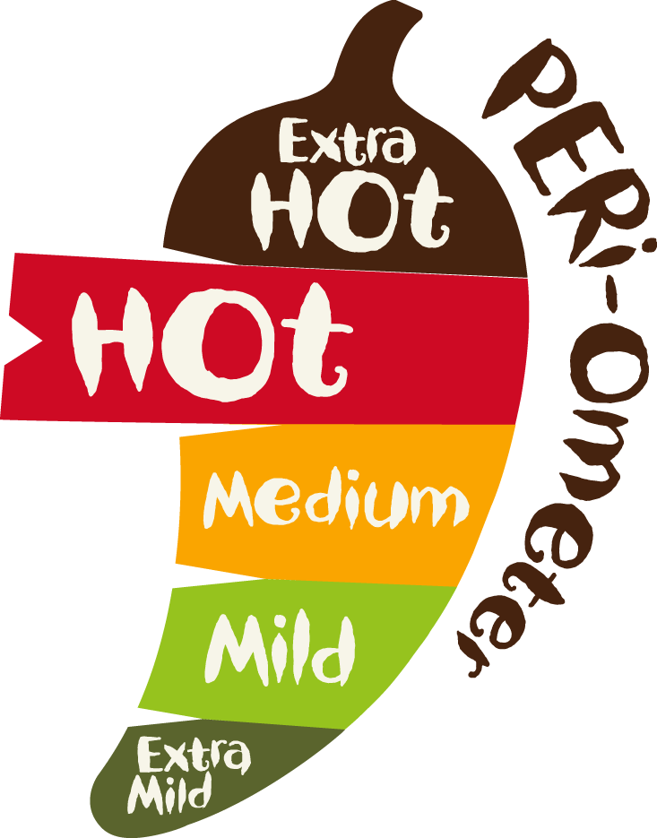
Title: Living with Tectonic Hazards
LO: Why do people choose to live near tectonic hazards?
Living in the Shadow of a Volcano: Mount Vesuvius - Italy
Activity: Use your device to research and answer the questions in ‘Living in the Shadow of Vesuvius.’
If you were in charge of disaster planning for Naples, which long-term actions (monitoring, planning or community strategies) would you prioritise to save lives and protect property and why?
If a major eruption of Mount Vesuvius was predicted tomorrow, which decisions would you make first to protect people, and why would these be the most important?
Notes:
https://www.youtube.com/watch?v=KClQk17F4pY

Slide 7
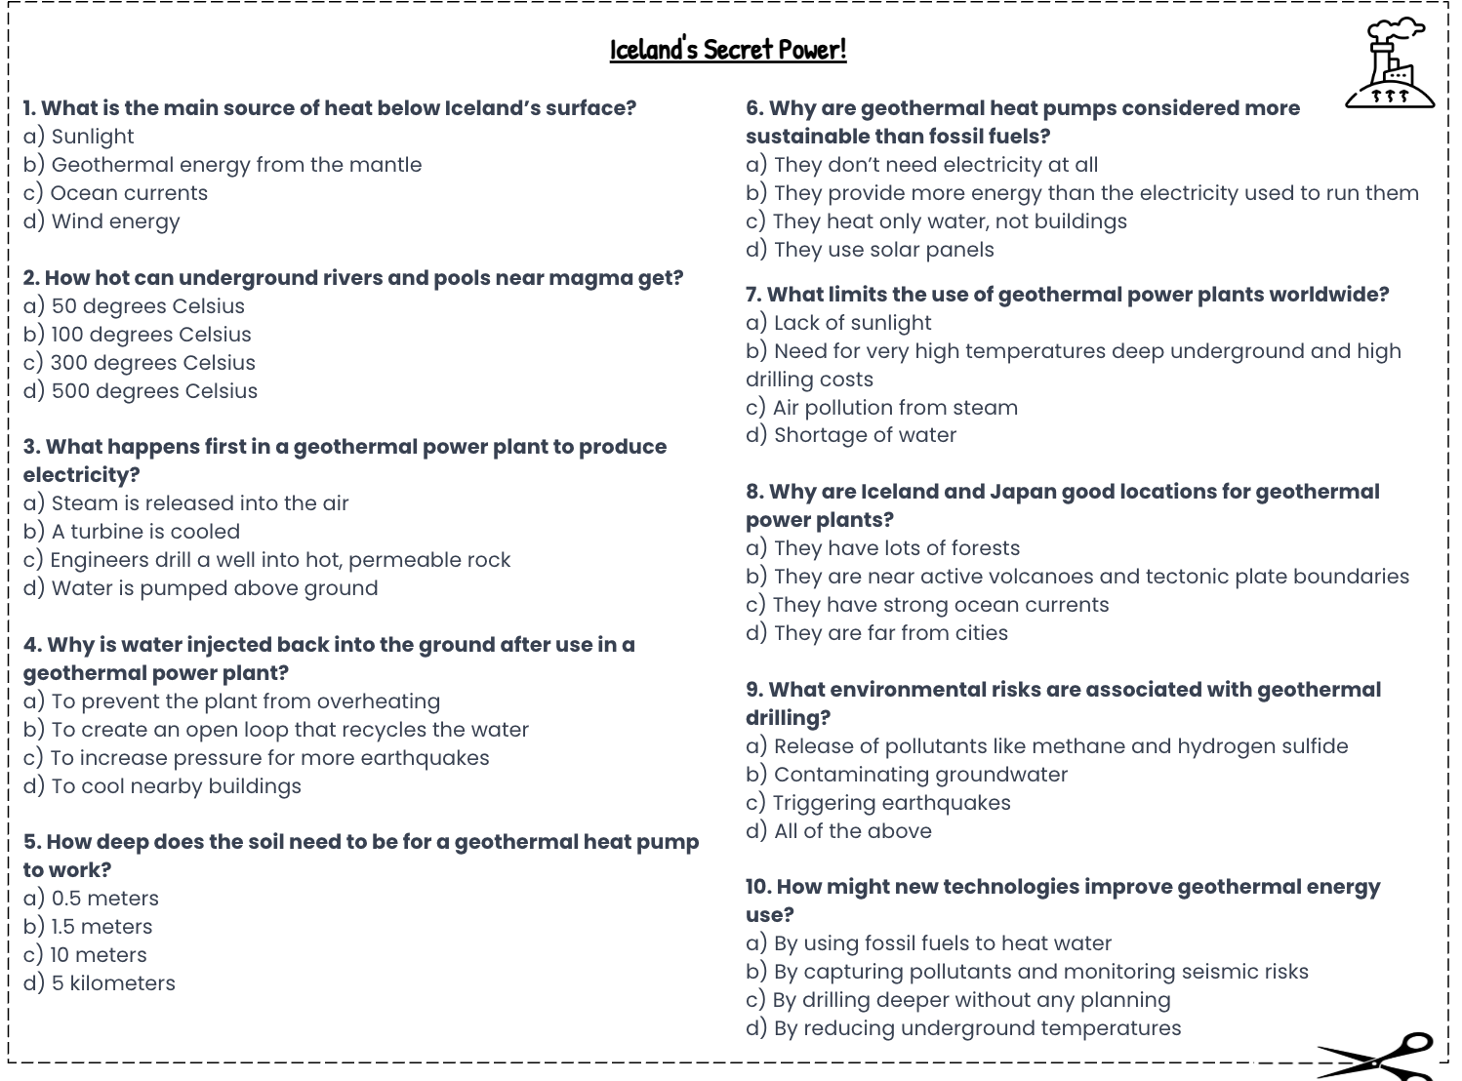
Title: Living with Tectonic Hazards
LO: Why do people choose to live near tectonic hazards?
Life on the Mid Atlantic Ridge: Iceland
b) Geothermal energy from the mantle
c) 300 degrees Celsius
a) Engineers drill a well into hot, permeable rock
d) To create an open loop that recycles the water
b) 1.5 meters
d) They provide more energy than the electricity used to run them
c) Need for very high temperatures deep underground and high drilling costs
a) They are near active volcanoes and tectonic plate boundaries
d) All of the above
b) By capturing pollutants and monitoring seismic risks
GREEN PEN YOUR ANSWERS

Slide 8
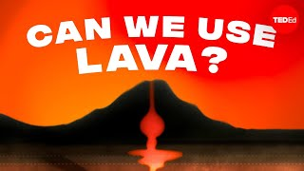
Title: Living with Tectonic Hazards
LO: Why do people choose to live near tectonic hazards?
Life on the Mid Atlantic Ridge: Iceland
Activity 1: Complete the multiple choice questions whilst watching the video:
Iceland's Secret Power!
Notes:
http://www.youtube.com/watch?v=5Hb_ONJUA9I

Slide 9
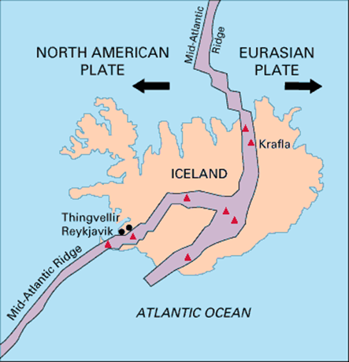
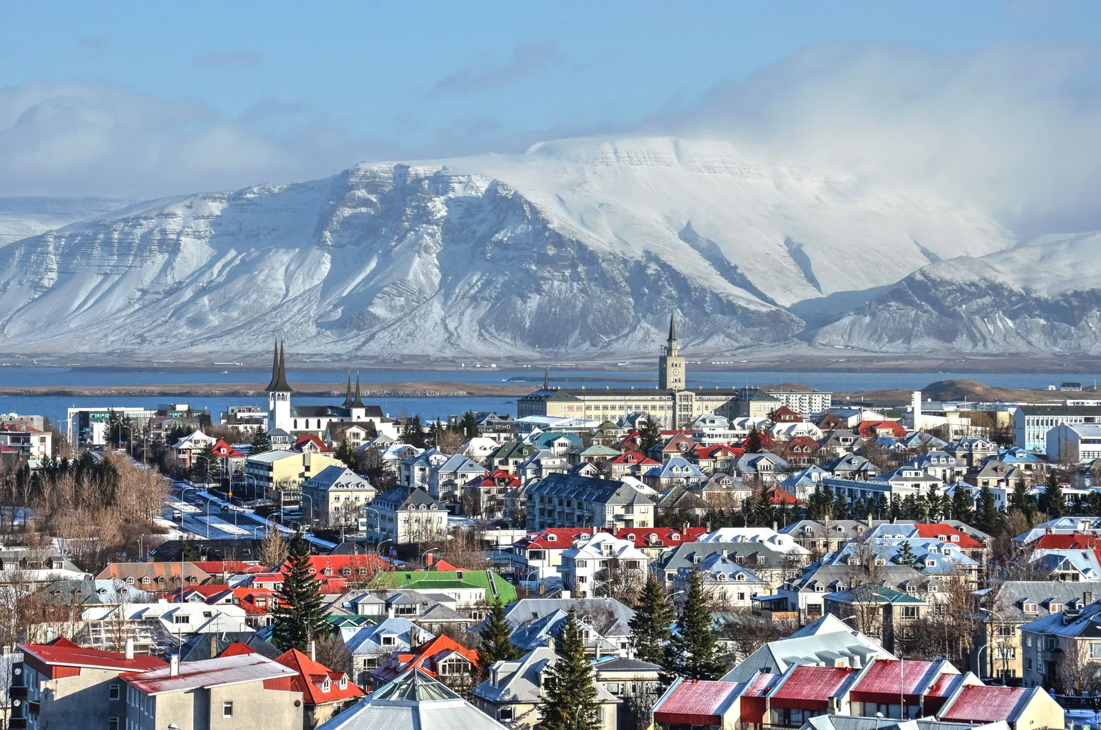
Title: Living with Tectonic Hazards
LO: Why do people choose to live near tectonic hazards?
Life on the Mid Atlantic Ridge: Iceland
Read the case study on Iceland
Iceland sits on the Mid-Atlantic Ridge, where two tectonic plates are moving apart. There are several active volcanoes, and a big eruption happens about every 5 years. Earthquakes also happen often.
Over 320,000 people live in Iceland, and more than 1 million visit each year. Even though earthquakes and volcanoes are a threat, people think the risk is low. This is because scientists carefully monitor the activity, and people know the dangers. In fact, the volcanic activity also brings many benefits to the country.

Slide 10


Title: Living with Tectonic Hazards
LO: Why do people choose to live near tectonic hazards?
How does Iceland benefit from it’s tectonic plate boundary?
Activity: Stick the strip in the middle of your page.
How Iceland benefits from it’s tectonic plate boundary? | Explanation
Hot water from within the earth's crust provides heat and hot water to nearly 90% of all buildings in Iceland | Making heat the usual way costs a lot and uses a lot of energy. Using geothermal heat saves money over time and does not produce carbon emissions.
Volcanic rocks are used in construction of roads and buildings.
The dramatic landscape with waterfalls, volcanoes and glaciers draw many tourists to Iceland.
Naturally occurring hot water is used to heat greenhouses and swimming pools.
Geothermal electricity is used to generate 25% of the country’s electricity.
The eruption of Eyjafjallajökull in 2010 made world headlines and drew attention to Iceland's volcanoes.
Using ‘Life and Energy in Iceland’ information for each box:
Notes:
https://www.youtube.com/watch?v=xuBheRSfa_k

Slide 11
How Iceland benefits from it’s tectonic plate boundary? | Explanation
Hot water from within the earth's crust provides heat and hot water to nearly 90% of all buildings in Iceland | Making heat the usual way costs a lot and uses a lot of energy. Using geothermal heat saves money over time and does not produce carbon emissions.
Volcanic rocks are used in construction of roads and buildings. | Using abundant local rock saves money because Iceland does not need to import expensive building materials from other countries, providing a cheap and durable supply for roads and structures.
The dramatic landscape with waterfalls, volcanoes and glaciers draw many tourists to Iceland. | Tourism brings a large amount of money into the local economy, creating jobs in hotels, restaurants, and tour companies, and helping the country grow financially.
Naturally occurring hot water is used to heat greenhouses and swimming pools. | Heated greenhouses allow Iceland to grow its own fresh fruit and vegetables year-round despite the cold climate, while heated outdoor pools provide affordable social and health spaces for locals and tourists.
Geothermal electricity is used to generate 25% of the country’s electricity. | It provides a reliable, clean, and renewable source of energy that reduces reliance on imported fossil fuels and helps keep energy prices stable and green.
The eruption of Eyjafjallajökull in 2010 made world headlines and drew attention to Iceland's volcanoes. | The worldwide news coverage put Iceland on the map, sparking global curiosity that led to a massive long-term surge in international tourism and geological research.

Slide 12


Title: Living with Tectonic Hazards
LO: Why do people choose to live near tectonic hazards?
Why do people choose to live near tectonic hazards?
🌋 What are some benefits of living near volcanoes or earthquake zones?
🏠 Why do people choose to stay in these areas even though they know the risks?
🌱 Why is Iceland a good example of how humans can live sustainably with their environment?
Notes:
https://dashboard.blooket.com/set/69157c94ade2e3b964a0bff5

